Slide 1
Astro 331
Spacecraft Propulsion Subsystem
SMAD Ch 17, Supp Crs Mtl

Slide 2
Lesson Objectives
Explain spacecraft propulsion system functions
Perform calculations using the ideal rocket equation and its variants
List and describe some common types of spacecraft propellant and their advantages and disadvantages
Understand and apply the concept of ullage
Calculate propellant tank volume, surface area, wall thickness, and mass

Slide 3
S/C Propulsion Functions
Provide thrust for attitude control, momentum dumping, and orbit maintenance
Transfer S/C from LEO orbits to higher orbits/interplanetary trajectories (apogee kick motor)

Slide 4
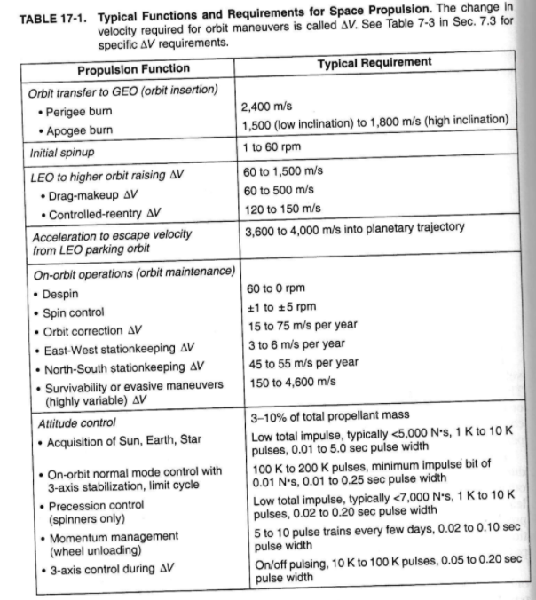

Slide 5
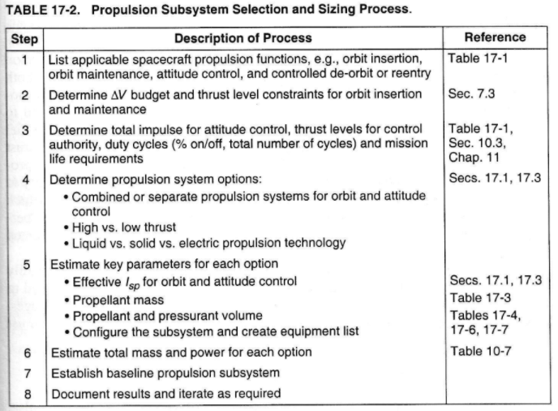

Slide 6
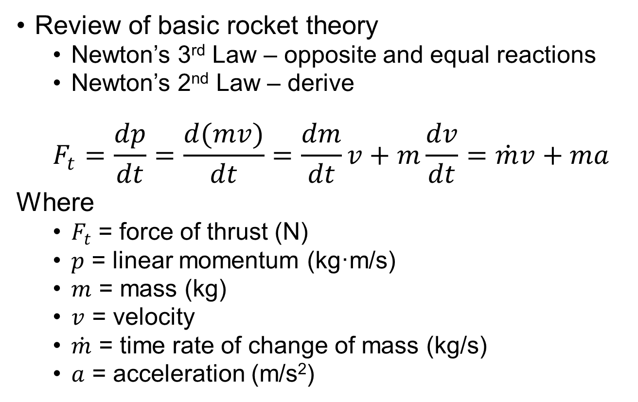
Ideal Rocket Eqn (and its variants)
Review of basic rocket theory
Newton’s 3rd Law – opposite and equal reactions
Newton’s 2nd Law – derive
$$F_{t}=\frac{dp}{dt}=\frac{d(mv)}{dt}=\frac{dm}{dt}v+m\frac{dv}{dt}=\dot{m}v+ma$$
Where
$F_{t}$ = force of thrust (N)
$p$ = linear momentum (kg·m/s)
$m$ = mass (kg)
$v$ = velocity
$\dot{m}$ = time rate of change of mass (kg/s)
$a$ = acceleration (m/s²)

Slide 7
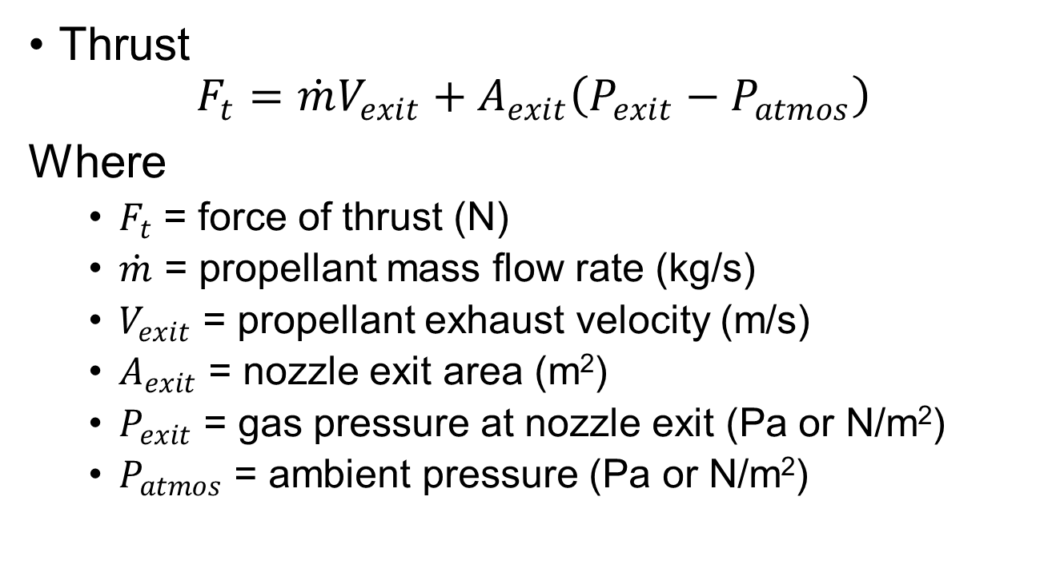
Basic Parameters of Rocket Design (1/2)
Thrust
$$F_{t}=\dot{m}V_{exit}+A_{exit}\left(P_{exit}−P_{atmos}\right)$$
Where
$F_{t}$ = force of thrust (N)
$\dot{m}$ = propellant mass flow rate (kg/s)
$V_{exit}$ = propellant exhaust velocity (m/s)
$A_{exit}$ = nozzle exit area (m²)
$P_{exit}$ = gas pressure at nozzle exit (Pa or N/m²)
$P_{atmos}$ = ambient pressure (Pa or N/m²)

Slide 8
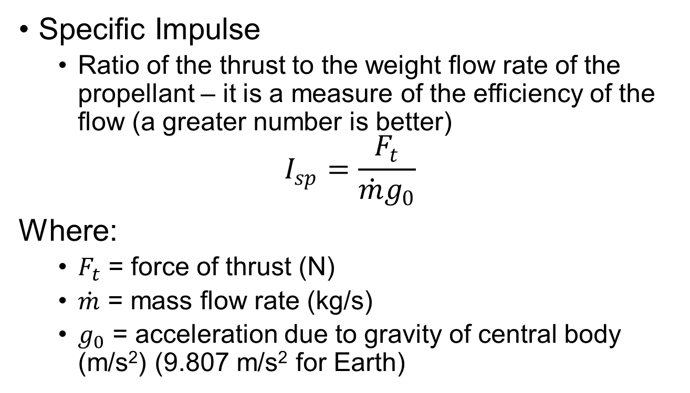
Basic Parameters of Rocket Design (2/2)
Specific Impulse
Ratio of the thrust to the weight flow rate of the propellant – it is a measure of the efficiency of the flow (a greater number is better)
$$I_{sp}=\frac{F_{t}}{\dot{m}g_{0}}$$
Where:
$F_{t}$ = force of thrust (N)
$\dot{m}$ = mass flow rate (kg/s)
$g_{0}$ = acceleration due to gravity of central body (m/s²) (9.807 m/s² for Earth)

Slide 9
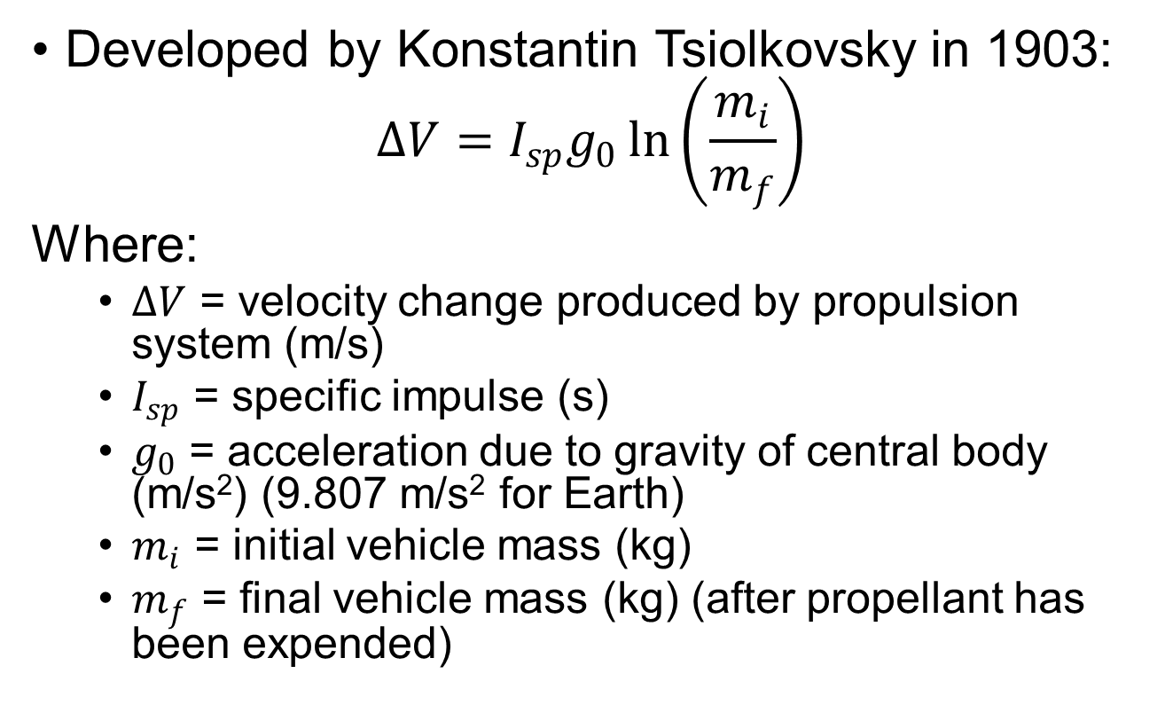
Ideal Rocket Equation
Developed by Konstantin Tsiolkovsky in 1903:
$$ΔV=I_{sp}g_{0}\ln\left(\frac{m_{i}}{m_{f}}\right)$$
Where:
$ΔV$ = velocity change produced by propulsion system (m/s)
$I_{sp}$ = specific impulse (s)
$g_{0}$ = acceleration due to gravity of central body (m/s²) (9.807 m/s² for Earth)
$m_{i}$ = initial vehicle mass (kg)
$m_{f}$ = final vehicle mass (kg) (after propellant has been expended)

Slide 10
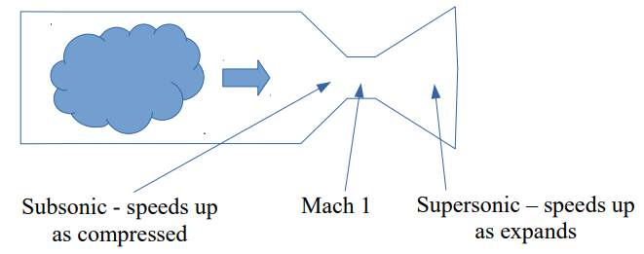
Classic Rocket Engine
Note that we achieve greatest thrust when exit pressure = ambient pressure
Although it looks like thrust would be greater with exit pressure greater than ambient pressure, the exhaust velocity is reduced, resulting in a loss of thrust
Thus, we design rocket exhaust nozzles with an exit pressure equal to ambient pressure whenever possible

Slide 11
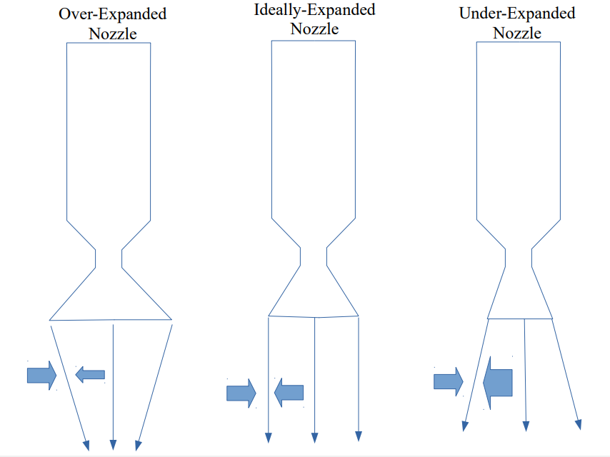
Nozzle Expansion
P_{atmos} > P_{exit}
P_{atmos} = P_{exit}
P_{atmos} < P_{exit}

Slide 12
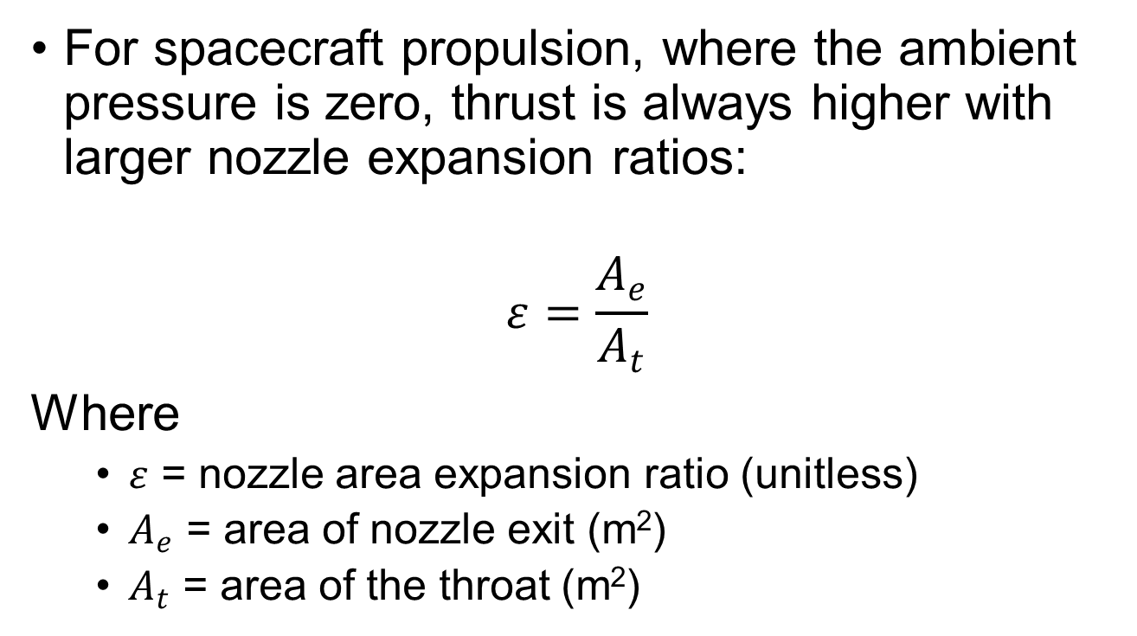
Nozzle Expansion
For spacecraft propulsion, where the ambient pressure is zero, thrust is always higher with larger nozzle expansion ratios:
$$ε=\frac{A_{e}}{A_{t}}$$
Where
$ε$ = nozzle area expansion ratio (unitless)
$A_{e}$ = area of nozzle exit (m²)
$A_{t}$ = area of the throat (m²)

Slide 13
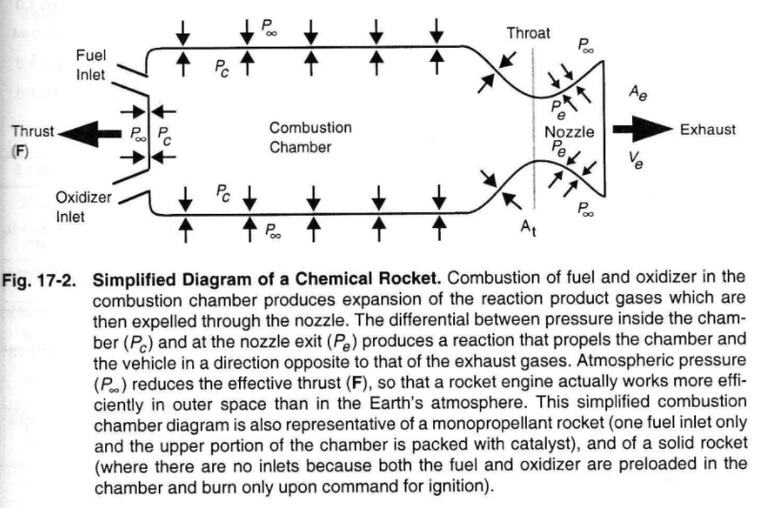

Slide 14
Common Types of Spacecraft Propellant (1/3)
Cold gas
Controlled, pressurized gas source with a nozzle
Simplest form of a rocket engine

Slide 15
Common Types of Spacecraft Propellant (2/3)
Chemical
Liquid: stored as liquids in tanks and fed on demand into the combustion chamber by gas pressurization or a pump
Bipropellant: chemically react a fuel and an oxidizer
Higher specific impulse but additional complexity and cost
Monopropellant: catalytically decompose a single propellant
Solid: stores propellants in solid form
lower specific impulse, but simpler than liquid engines
Hybrid: propellants are stored in different forms; typically, fuel is solid and oxidizer is a liquid or gas
Attractive because of safety, allow for throttling and restart, fuel storability, environmentally clean

Slide 16
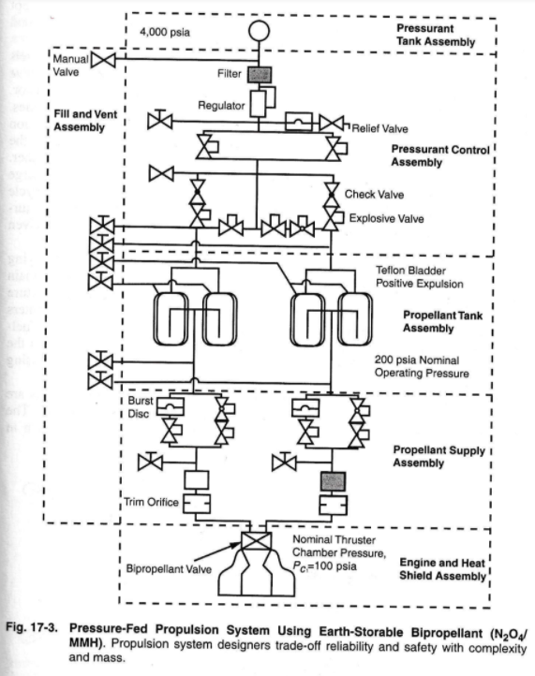
Liquid Bipropellant

Slide 17
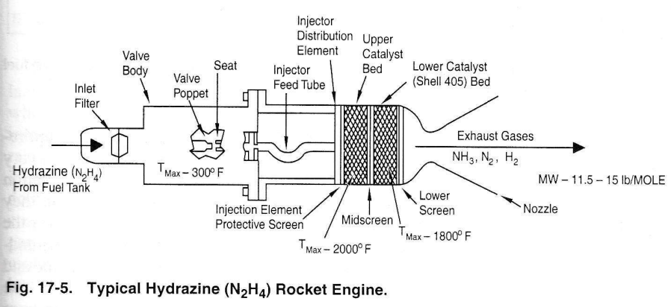
Liquid Monopropellant

Slide 18
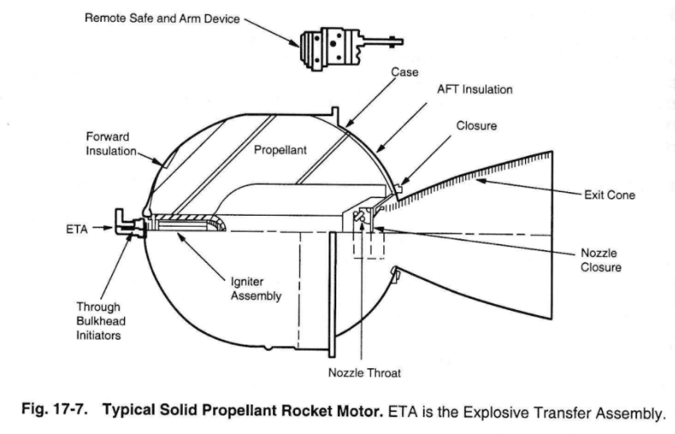
Solid

Slide 19
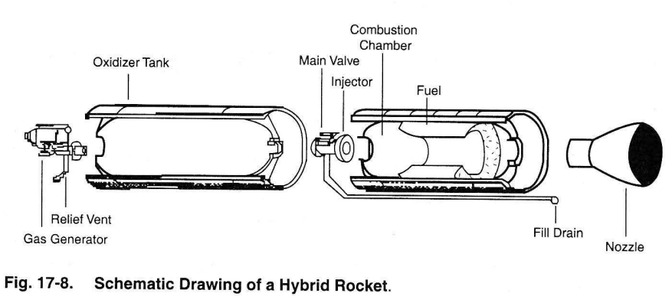
Hybrid

Slide 20
Common Types of Spacecraft Propellant (3/3)
Electric: uses externally provided electrical power either from Sun or from nuclear or thermodynamic conversion, to accelerate fluid to produce thrust
Electrothermal: gas heat via resistance element or arc and expanded through nozzle
Electrostatic: ions electrostatically accelerated
Electromagnetic: plasma accelerated via interaction of current and magnetic field

Slide 21
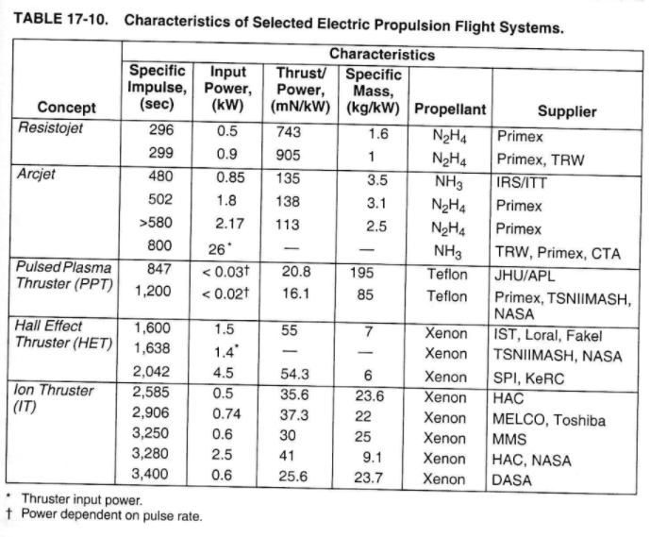

Slide 22
Advanced Propulsion Concepts (gee-whiz)
Solar Sails – large sheets of thin reflective material, using photons to push the sail
Solar Thermal – use large solar reflectors to heat propellant in a “combustion” chamber
Nuclear Thermal – heat propellant in “combustion” chamber using a nuclear reactor
Electrodynamic Tether – run current through a tether to “push” off Earth’s magnetic field

Slide 23
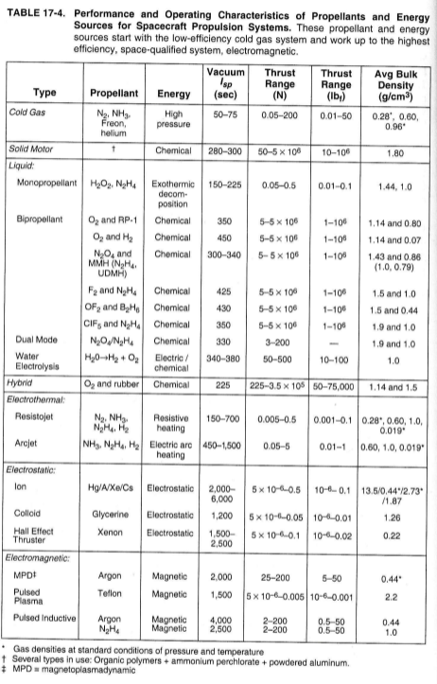
Performance Comparison of Different Propellants

Slide 24
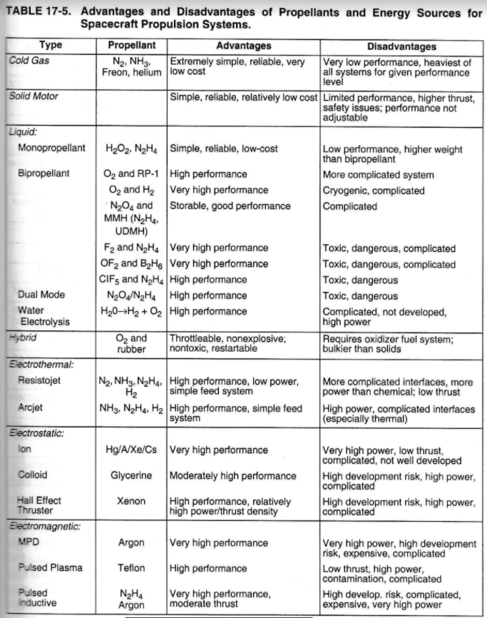
Advantages & Disadvantages of Different Propellants

Slide 25
Propulsion Systems Suitability

Slide 26
Propellant Tank Sizing
Calculate propellant volume using densities (Table 17-4)
Not only does the tank need to account for the required propellant for the mission, but it also needs to account for ullage volume & possible shrinkage (an issue for cryogenic fuels)
Ullage: extra tank volume at the top of the tank to provide space for pressurization gas

Slide 27
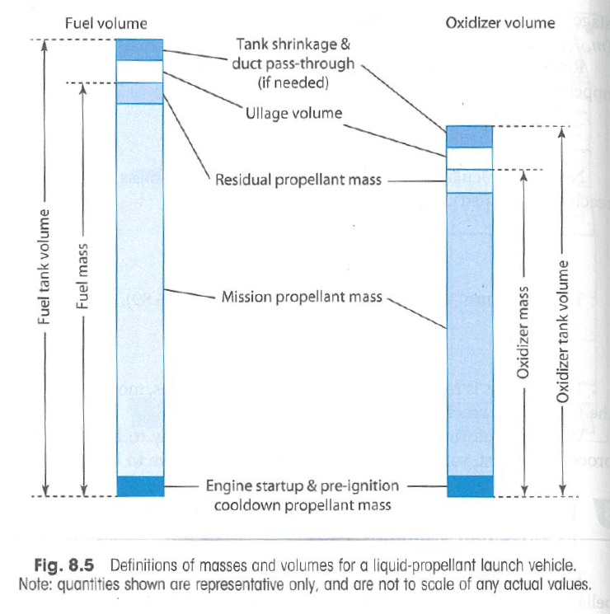

Slide 28
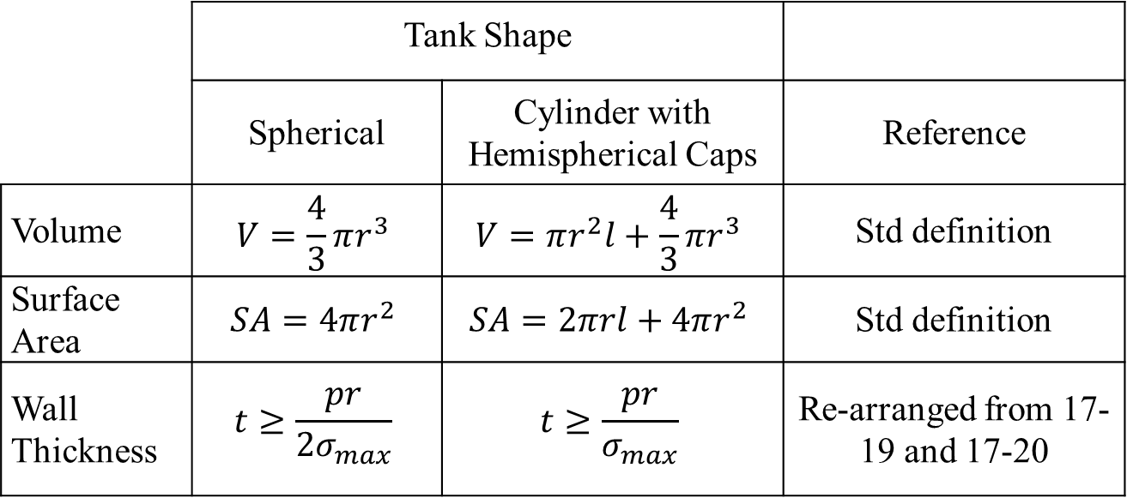
Calculate Tank Size (1/2)
Select general tank geometry: solve for dimensions and mass
 | Tank Shape
 | Spherical | Cylinder with Hemispherical Caps | Reference
Volume | $$V=\frac{4}{3}πr^{3}$$ | $$V=πr^{2}l+\frac{4}{3}πr^{3}$$ | Std definition
Surface Area | $$SA=4πr^{2}$$ | $$SA=2πrl+4πr^{2}$$ | Std definition
Wall Thickness | $$t≥\frac{pr}{{2σ}_{max}}$$ | $$t≥\frac{pr}{σ_{max}}$$ | Re-arranged from 17-19 and 17-20

Slide 29
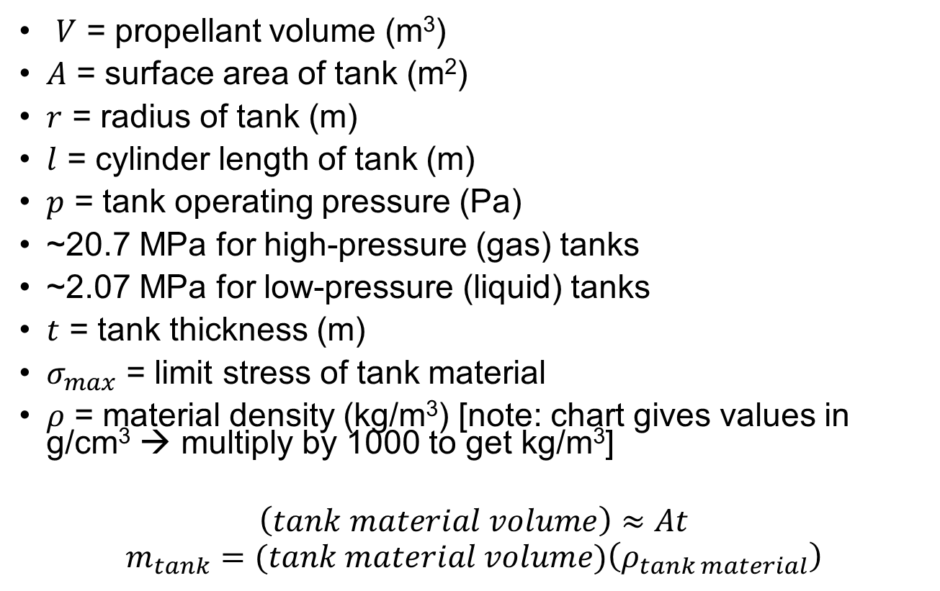
Calculate Tank Size (2/2)
$V$ = propellant volume (m³)
$A$ = surface area of tank (m²)
$r$ = radius of tank (m)
$l$ = cylinder length of tank (m)
$p$ = tank operating pressure (Pa)
~20.7 MPa for high-pressure (gas) tanks
~2.07 MPa for low-pressure (liquid) tanks
$t$ = tank thickness (m)
$σ_{max}$ = limit stress of tank material
$ρ$ = material density (kg/m³) [note: chart gives values in g/cm³ → multiply by 1000 to get kg/m³]
$$\left(tank material volume\right)≈At$$
$$m_{tank}=(tank material volume)\left(ρ_{tank material}\right)$$

Slide 30
Example
Given: A spacecraft to be launched into geostationary orbit will have a 7 year mission life and a dry mass of 2000 kg. The spacecraft will use hydrazine monopropellant for its on-board propulsion. It will require the following delta Vs for station-keeping and orbit correction. Assume you will need 10% ullage volume.
Find: •You are the propulsion engineer. Calculate the tank volume and mass for a cylindrical tank with hemispheric caps if it were made out of Aluminum vs Titanium. The chief engineer has asked you to keep the tank to no wider than 1 meter and the length to no longer than 2 meters. Assume a factor of safety of 1.25 for ultimate strength and 1.1 for yield strength. Use the following information to perform your calculations.
N/S stationkeeping (m/s/yr) | 55
E/W stationkeeping (m/s/yr) | 6
Orbit corrections (m/s/yr) | 15
 | 7075 Aluminum | Titanium
Density (kg/m³) | 2800 | 4430
Yield Strength (MPa) | 500 | 880
Ultimate Strength (MPa) | 570 | 950

Slide 31
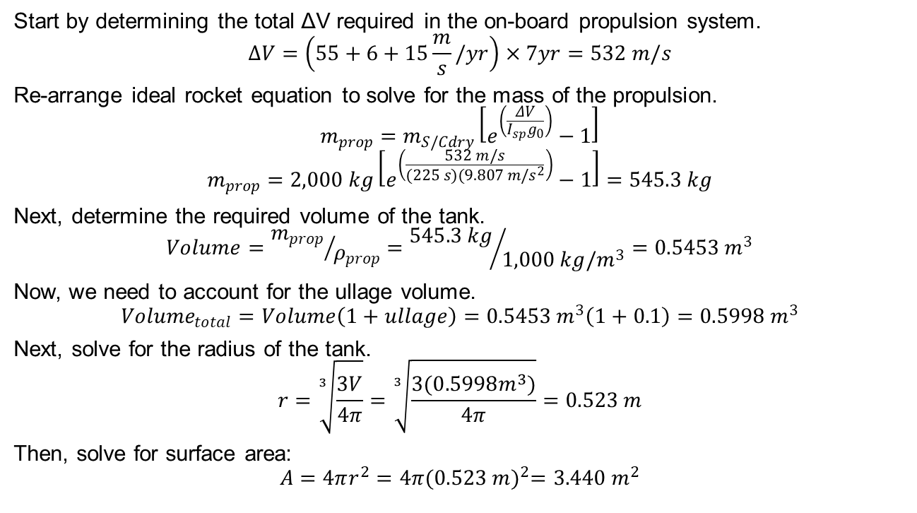
Solution (1/3)
Start by determining the total ΔV required in the on-board propulsion system.
$$∆V=\left(55+6+15\frac{m}{s}/yr\right)×7yr=532 m/s$$
Re-arrange ideal rocket equation to solve for the mass of the propulsion.
$$m_{prop}=m_{S/Cdry}\left[e^{\left(\frac{ΔV}{I_{sp}g_{0}}\right)}−1\right]$$
$$m_{prop}=2,000 kg\left[e^{\left(\frac{532 m/s}{(225 s)(9.807 m/s^{2}}\right)}−1\right]=545.3 kg$$
Next, determine the required volume of the tank.
$$Volume={m_{prop}}/{ρ_{prop}}={545.3 kg}/{1,000 kg/m^{3}}=0.5453 m^{3}$$
Now, we need to account for the ullage volume.
$${Volume}_{total}=Volume\left(1+ullage\right)=0.5453 m^{3}\left(1+0.1\right)=0.5998 m^{3}$$
Next, solve for the radius of the tank.
$$r=\sqrt[3]{\frac{3V}{4π}}=\sqrt[3]{\frac{3(0.5998m^{3})}{4π}}=0.523 m$$
Then, solve for surface area:
$$A=4πr^{2}=4π{(0.523 m)}^{2}=3.440 m^{2}$$

Slide 32
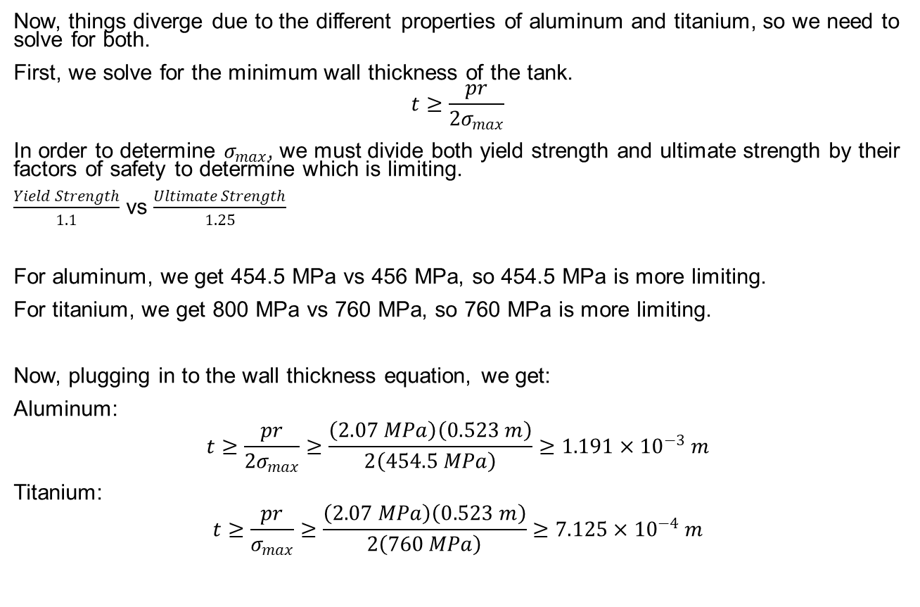
Solution (2/3)
Now, things diverge due to the different properties of aluminum and titanium, so we need to solve for both.
First, we solve for the minimum wall thickness of the tank.
$$t≥\frac{pr}{2σ_{max}}$$
In order to determine $σ_{max}$, we must divide both yield strength and ultimate strength by their factors of safety to determine which is limiting.
$\frac{Yield Strength}{1.1}$ vs $\frac{Ultimate Strength}{1.25}$
For aluminum, we get 454.5 MPa vs 456 MPa, so 454.5 MPa is more limiting.
For titanium, we get 800 MPa vs 760 MPa, so 760 MPa is more limiting.
Now, plugging in to the wall thickness equation, we get:
Aluminum:
$$t≥\frac{pr}{2σ_{max}}≥\frac{\left(2.07 MPa\right)\left(0.523 m\right)}{2\left(454.5 MPa\right)}≥1.191×{10}^{−3} m$$
Titanium:
$$t≥\frac{pr}{σ_{max}}≥\frac{\left(2.07 MPa\right)\left(0.523 m\right)}{2\left(760 MPa\right)}≥7.125×{10}^{−4} m$$

Slide 33
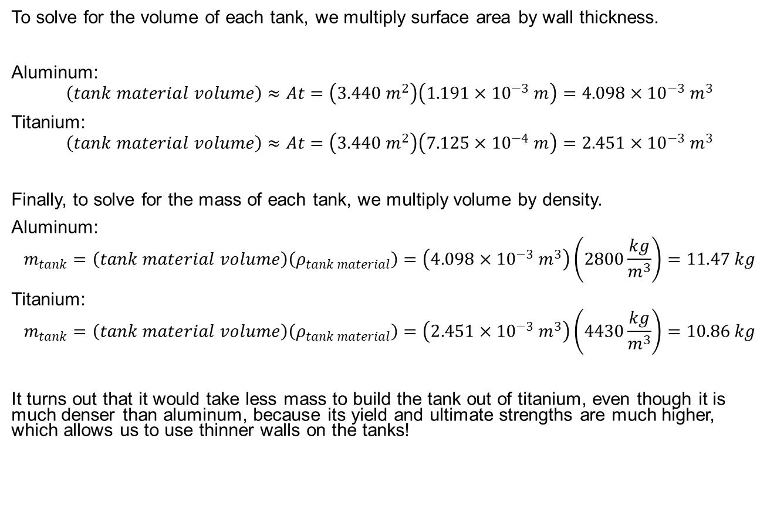
Solution (3/3)
To solve for the volume of each tank, we multiply surface area by wall thickness.
Aluminum:
$$\left(tank material volume\right)≈At=\left(3.440 m^{2}\right)\left(1.191×{10}^{−3} m\right)=4.098×{10}^{−3} m^{3}$$
Titanium:
$$\left(tank material volume\right)≈At=\left(3.440 m^{2}\right)\left(7.125×{10}^{−4} m\right)=2.451×{10}^{−3} m^{3}$$
Finally, to solve for the mass of each tank, we multiply volume by density.
Aluminum:
$$m_{tank}=\left(tank material volume\right)\left(ρ_{tank material}\right)=\left(4.098×{10}^{−3} m^{3}\right)\left(2800\frac{kg}{m^{3}}\right)=11.47 kg$$
Titanium:
$$m_{tank}=\left(tank material volume\right)\left(ρ_{tank material}\right)=\left(2.451×{10}^{−3} m^{3}\right)\left(4430\frac{kg}{m^{3}}\right)=10.86 kg$$
It turns out that it would take less mass to build the tank out of titanium, even though it is much denser than aluminum, because its yield and ultimate strengths are much higher, which allows us to use thinner walls on the tanks!

